Slide 1

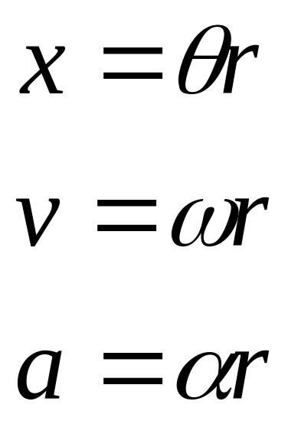
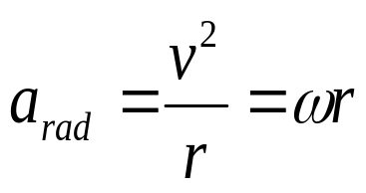
Circular motion
Physics 131
Lecture 6
Today:
Angular coordinate θ in units of radians
Angular velocity ω, units rad s⁻¹. It is a vector quantity
Angular acceleration has two components
and tangential acceleration α. Both vectors
All found in Young and Freedman, University Physics, 3.4 and 9.1, 9.2 and 9.3
Notes:
Demo – ball with electromagnet held with switch swinging around.

Slide 2
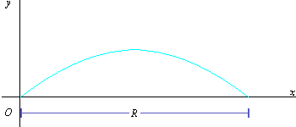
Review
Projectile motion: 2 conditions…
So v_{x}= constant v_{y} = v₀-gt
Constant horizontal velocity
Accelerating in vertically with gravity -9.8m/s²
Notes:
Last lecture we looked at Projectile motion, specifically
Analysis of projectile motion
Equations for projectile motion (see slide)
Solving problems with the above
Range can be calculated by letting y=0
Height time by vy=0

Slide 3

The longest car jump attempt

Slide 4
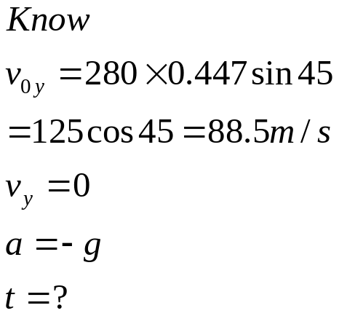
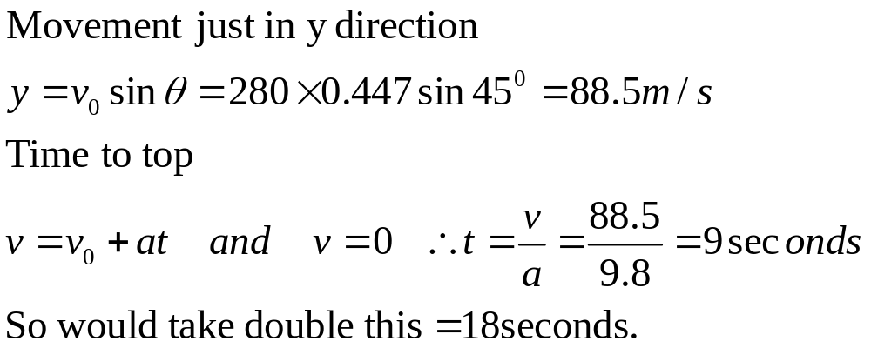
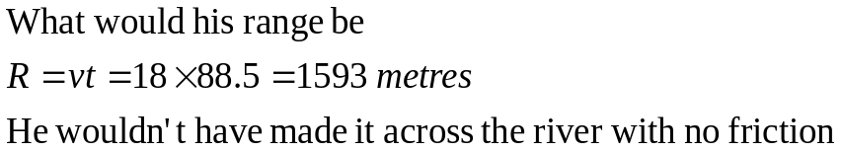
How much time in the air?
1 mile is 1 609 metres 1 mph is 0.447 m/s
Ignoring the height of the take off ramp, which is at 45⁰, how long would the car be in the air for according to given 280m/h initial velocity?
What range would this give?

Slide 5
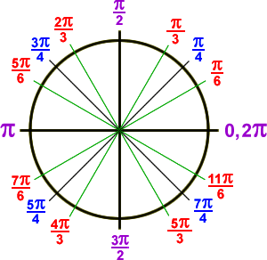
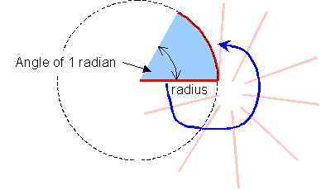
Angular coordinate Ө
In describing the rotational motion, the most natural way to measure the angle Ө is not in degrees, but in radians.
Notes:
When describing rotational motion using this angular coordinate we find that A rotating object undergoes an angular displacement in a similar way that a particle undergoes x and y displacement when the motion is linear.
The SI unit for the angular coordinate is radians.

Slide 6
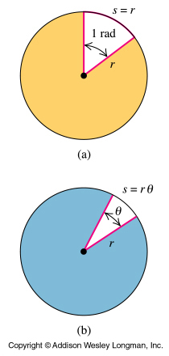
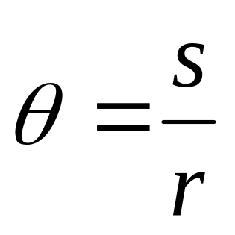
Angular displacement is in radians
An angle θ in radians is defined as the ratio of the arc length s to the radius r.
π/2
π
When s = r we have the definition of 1 radian
1 rad = 360⁰/2π = 57.3⁰
2π
3π/2
Notes:
As an object moves around a circle- it is easier to describe its path in terms of angle…rather than speed…Since speed depends on distance from the axis…
An angle theta in radians is defined as the ratio of the arc length s to the radius r. It is the ratio of two numbers and so is dimensionless.,
When s=r we have the definition of 1 radian relationship between radians and ordinary angle is 1 rad = 360⁰/2πι (τηετα = σ/ρ ωηιχη φορ α ωηολε χιρχλε = 360 δεγρεεσ ανδ ισ 2∗πι∗ρ/ρ= 2 πι ραδιανσ. Τηερεφορε 2 Πι ραδσ = 360 δεγρεεσ τηερεφορε 1 ραδ = 360/2πι.

Slide 7
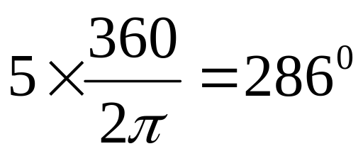
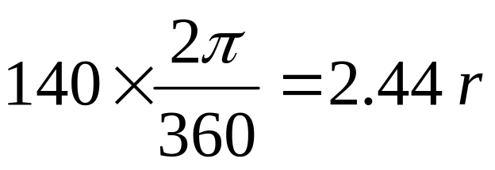
Radians and degrees
Convert 5 radians to degrees
Convert 140⁰ to radians

Slide 8
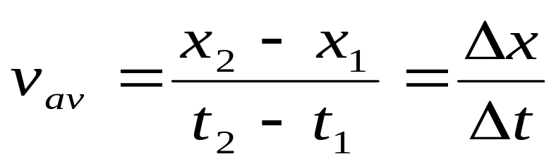
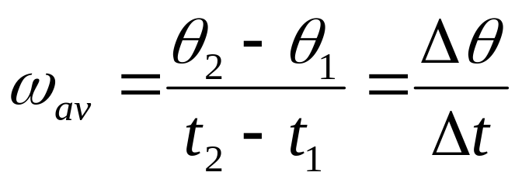
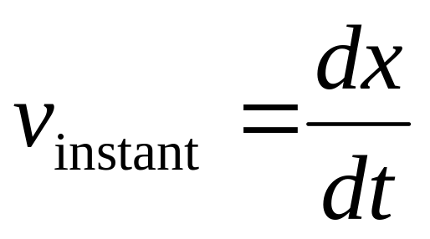
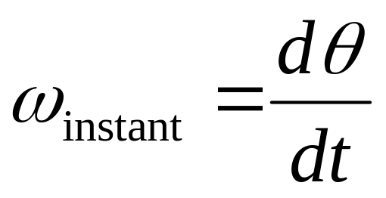
Angular velocity
Linear motion
Angular motion
SI unit m/s
SI unit rad/s
Notes:
For linear motion the velocity was as shown – the change in the x coordinate / change in time during which the change in x occurred. It is similar for angular velocity except the coordinate that changes in this case is the angle theta. So we have the equations shown. Basically we had linear velocity = rate of change of position x, angular velocity = rate of change of angle theta.

Slide 9







Angular velocity ω
A grasshopper is positioned near the outside and a ladybird is positioned on the inside of a rotating DVD.
Which has the highest speed
Grasshopper
Which has the highest angular speed ω
Both the same since angular velocity is change in angle/change in time. Both rotating with the disk.

Slide 10
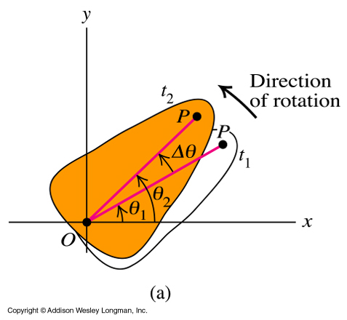
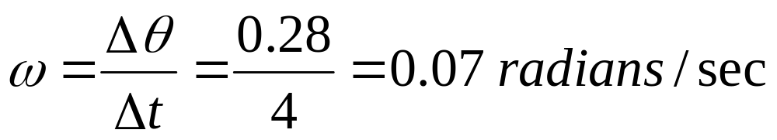
Angular velocity
A rock is spinning. If it rotates 0.28 radians in 4 seconds, what is its rotational velocity?
Notes:
For linear motion the velocity was as shown – the change in the x coordinate / change in time during which the change in x occurred. It is similar for angular velocity except the coordinate that changes in this case is the angle theta. So we have the equations shown. Basically we had linear velocity = rate of change of position x, angular velocity = rate of change of angle theta.

Slide 11
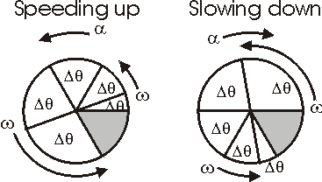
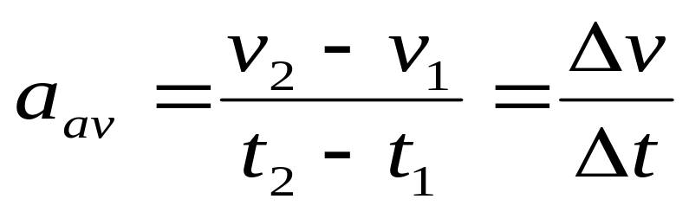
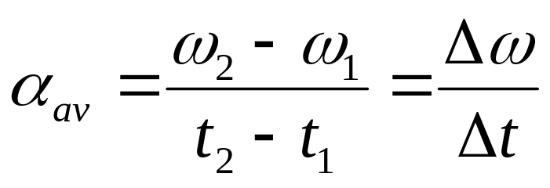
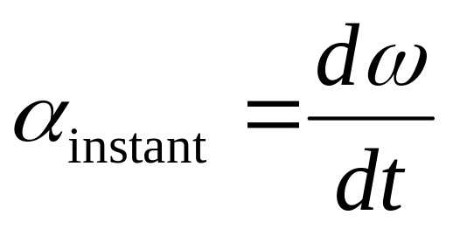
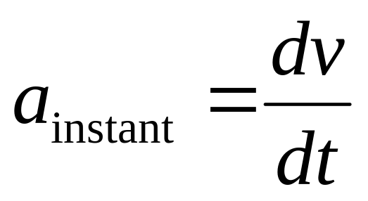
Angular acceleration (tangential)
Linear acceleration
Angular acceleration
SI unit rad/s²
SI unit m/s²
What direction?
Notes:
For linear motion the velocity was as shown – the change in the x coordinate / change in time during which the change in x occurred. It is similar for angular velocity except the coordinate that changes in this case is the angle theta. So we have the equations shown. Basically we had linear velocity = rate of change of position x, angular velocity = rate of change of angle theta.
We find the same holds for angular accn….when the angular velocity of a rigid body changes, it has an angular accn. Just like for linear motion where the velocity changed, then there was linear accn. Angular accn is given the symbol alpha and is measured in rad/s². The equations are as shown.
@ We can draw the posiition of an object with + acceleration and – acceleration.
@ given by acceleration equation

Slide 12
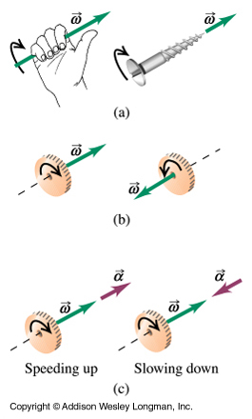
What directions are the angular velocity ω and acceleration α?
Answer: Along the axis
In angular motion the angular velocity vector, ω, is directed along the axis of rotation. Its direction is governed by the right hand rule.
α is also along the axis. It points in the same direction as ω if the rotation is speeding up, and opposite if the rotation is slowing down.
Notes:
So now we know how to calculate these quantities, what about finding their direction ?
Again just as for the linear case, the angular velocity and accn are vector quantities..they have magnitude and direction. In linear motion the velocity was at a tangent to the particles path and the accn was in the direction of delta v.
In angular motion the angular velocity vector, omega, is directed along the axis of rotation.
Its direction is governed by the right hand rule. So as see in figure b if we take our right hand and direct our fingers in the direction of the rotation, our thumb points in the direction of omega.
If the direction of the axis is fixed then alpha, the angular accn, is also along the axis. It points in the same direction as omega if it is speeding up, and opposite if the rotation is slowing down.

Slide 13
How do you convert circular measurements to linear measurements?
Since θ=x/r Rearrange
Multiply any circular measurement, by r and you have linear measurement

Slide 14
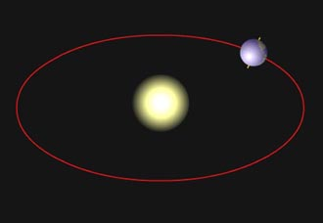
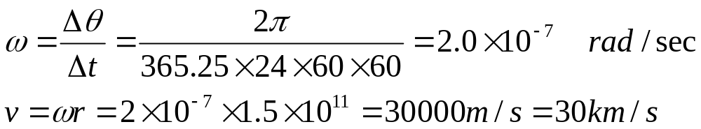

Orbit of Earth around Sun
The Earth orbits the Sun in 365.25 days. Calculate the angular velocity ω.
If the average radius of the Earths orbit is 1.5x10¹¹ m. Calculate the velocity of the Earth due to this orbit.

Slide 15
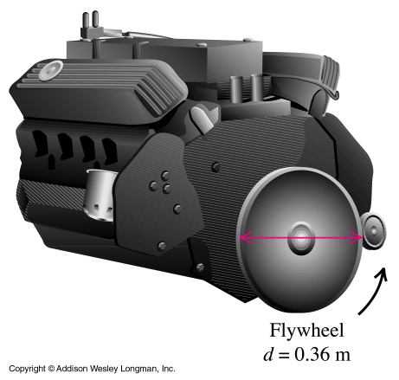
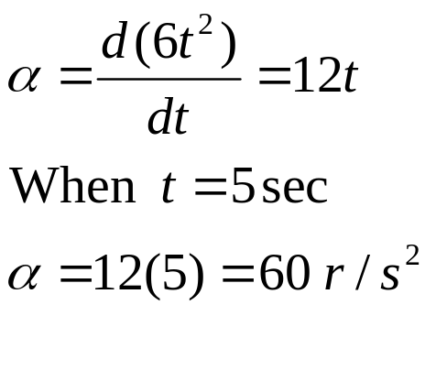
9.2 Calculating angular acceleration
A rotating flywheel obeys the following equation
ω = 6t²
Find the instantaneous angular acceleration at time t = 5 sec.

Slide 16
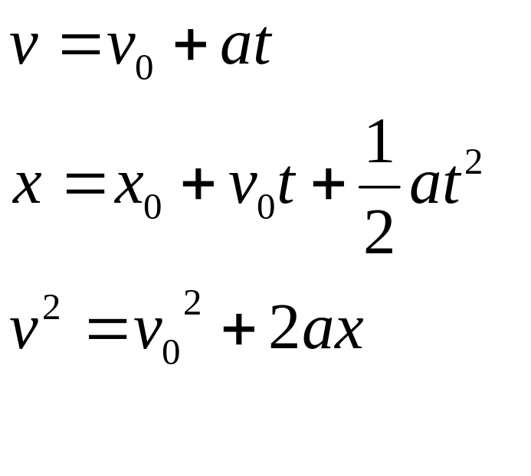
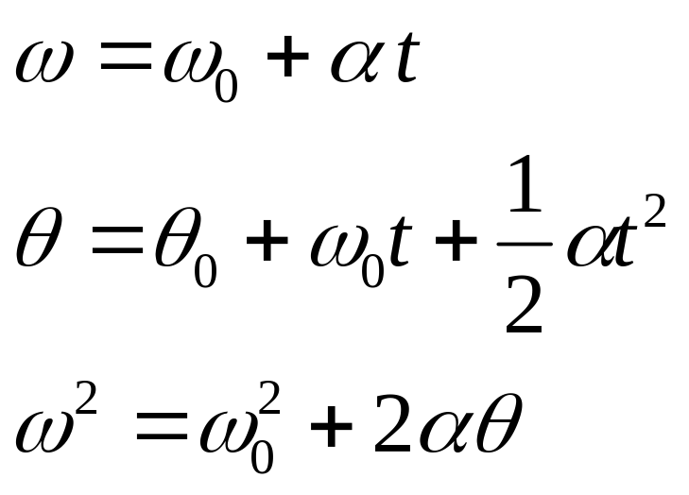
Comparison -equations with constant acceleration
Linear equations Circular equations
Convert angular to linear
Notes:
We can write out the linear equations of motion, and turn them into rotational equations of motion .. By simply changing the symbols from linear to rotational…
Remember it’s constant accn, just as was for linear motion.

Slide 17
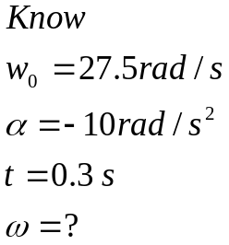
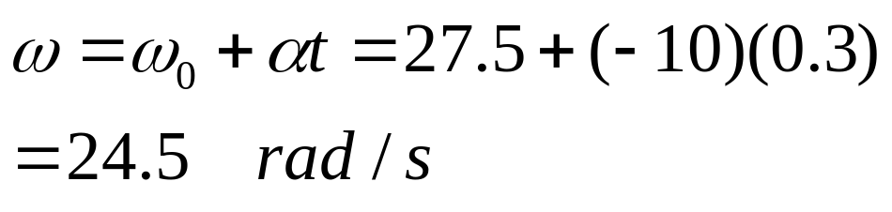

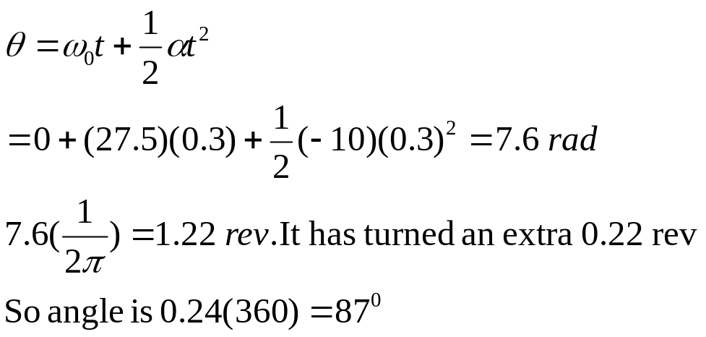
Example 9.3 DVD
A DVD is slowing to a stop. The angular velocity of the disc at t = 0 is 27.5 rad/s, and its angular acceleration is a constant -10 rad/s².
A line PO on the surface lies on the x axis at t = 0.
a) What is the disc’s angular velocity at t = 0.3 s?
x
b) What angle does the line PO make with the +x axis at this time in degrees?
0
P
Notes:
Example 9-3

Slide 18
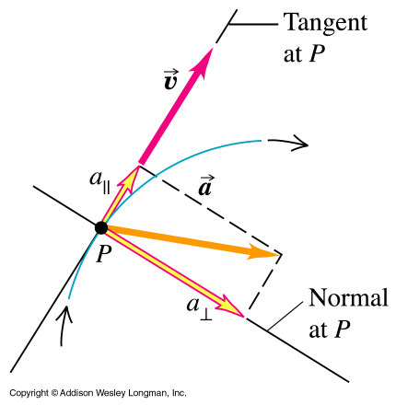
Parallel and perpendicular components of vector a
The instantaneous acceleration vector can be separated into a component parallel to the velocity vector = tangential acceleration α and perpendicular to it = radial acceleration r⊥

Slide 19
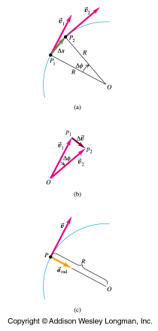
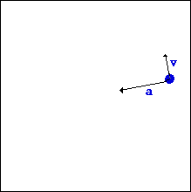
Radial Acceleration
In uniform circular motion (constant speed) we have only a perpendicular component of acceleration, directed towards the centre of the circle. It is called the radial acceleration – along the radius of the circle.
Notes:
So in uniform circular motion we have only accn perpendicular to motion, called radial accn in this case. It is directed towards the centre of the circle. Now we need to see how we can calculate the value for this accn when we know things like the velocity of the particle and the radius of the circle around which it travels.
I am not going to go through the derivation (it’s on page 76 of Y&F if you’re interested) of the equations used to find this accn, I’ll just show them to you and show how to use them

Slide 20
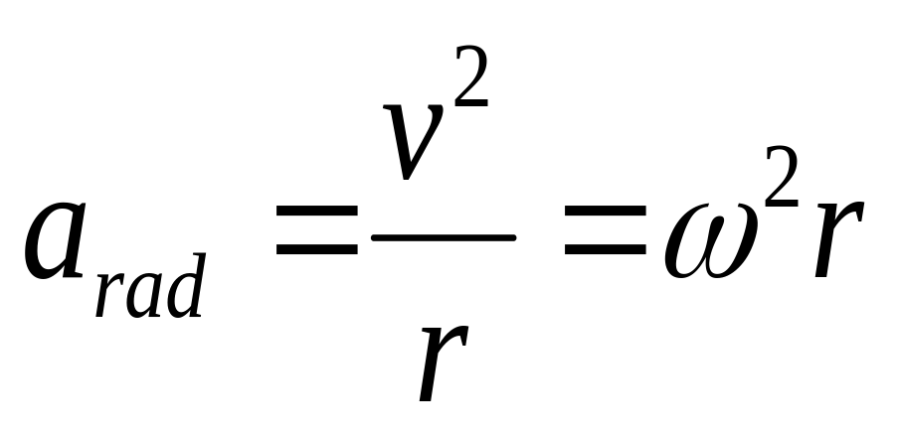
In uniform circular motion, the magnitude a of the instantaneous acceleration is equal to the square of the speed v divided by the radius R of the circle. Its direction is perpendicular to v, and inward along the radius.
It is sometimes called the centripetal acceleration
Since v=ωr
Notes:
In uniform circular motion, the magnitude a of the instantaneous acceleration is equal to the square of the speed v divided by the radius R of the circle. Its direction is perpendicular to v, and inward along the radius.SEE SLIDE FOR EQN.
It is sometimes called the centripetal acceleration
It can also be found using the value of the period of circulation rather than from the velocity. SEE SLIDE FOR EQN.
(Velocity = distance over time = circumference of circle /time and circ = 2piR so v squared = 4 pi squared R squared so get
a(rad)=v squared/R = 4 pi squared R squared /T squared (where T = period or time to go round once)
= 4 pi squared R squared /(T squared *R) = 4 pi squared R /T squared

Slide 21
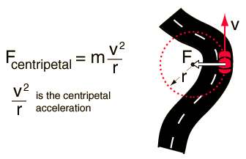

Slide 22
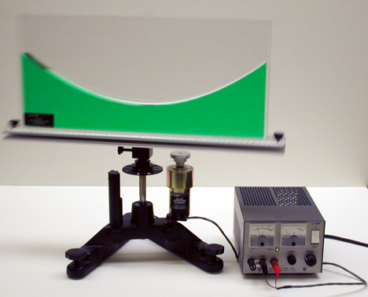
Water responding to the radial acceleration.
Notes:
Demo- Water in laser experiment-acceleration
The particles on the outside of this fluid want to keep going straight ahead. Hoever the container keeps accelerating them to the inside.

Slide 23

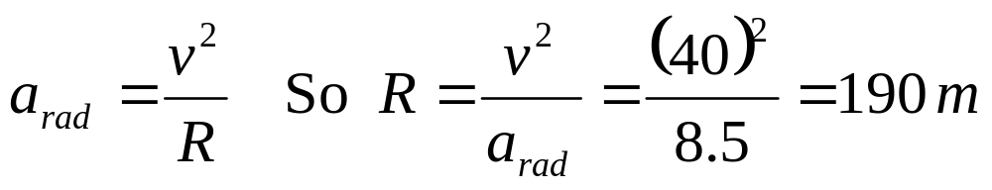
Example 3.12 Centripetal acceleration on a curved road.
When turning a corner a BMW Z4 roadster can hold a lateral acceleration of 0.87g, which is 0.87(9.8) = 8.5 m/s². Any higher lateral acceleration and the car would skid out of the circular path.
If the car is travelling at a constant 40 m/s, what is the minimum radius of curve it can negotiate? Assume it has the same lateral acceleration limit.
Notes:
Any small radius of curvature- would create a larger radial acceleration

Slide 24
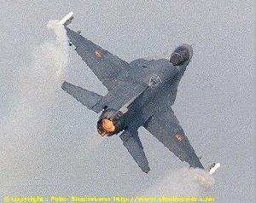
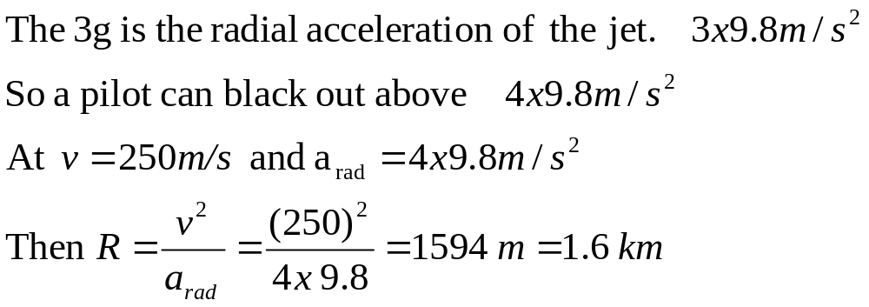
Example Jets
In a backward turn, jet pilots talk about “pulling 3g” and blacking out at 4g. What are they talking about?
If a jet is travelling at 250 m/s what is the smallest radius of curvature the pilot can withstand using 4g?

Slide 25
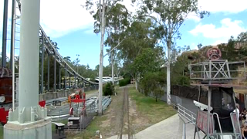
The Tower of Terror

Slide 26
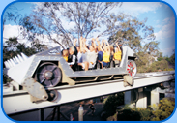

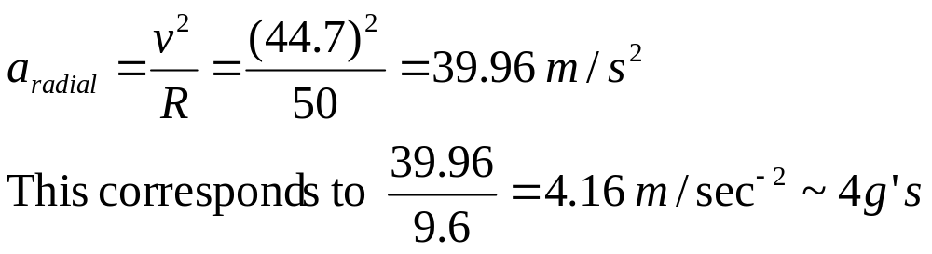
Example- The tower of Terror in Dream world
The car reaches a speed of 44.7 m/s?
The radius of curvature on the track is 50 m. How many g’s does it pull?
115 m
Notes:
Lets look at the stats.
2.2 MW of electrical power in the form of a magnetic- Linear synchronous motor
The curve pulls about 4gs The initial acceleration is abnout this.
Pilots in planes can withstand 5gs before they black out. A modern fighter jet can withstand about 10gs before the wings start falling off.
How many g’s can a person withstand…. Well there is a story about a man called Murphy.
He was the guinea pig on a railway car that was subjected to enormous forces to produce enourmous acceleration.
They did a final test one day to see how much acceleration Murphy could withstand.
They subjected him to about 48 gs. He had bleeding eyes and ears and brusing. He of course was well past blacking out.
No one realyy knows the exact acceleration that he was subjected to however because the “accelerometer” didn’t work…. Murphy for some reason didn’t want to repeat the experiment…..So this was the beginning of “Murphies Laws”……

Slide 27
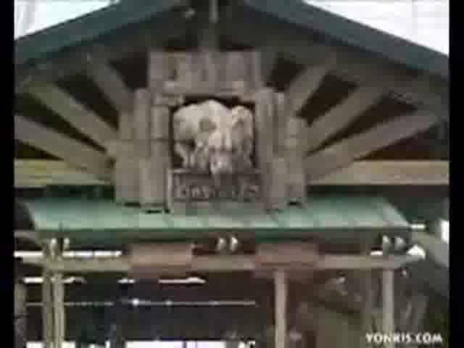

Slide 28


Slide 29
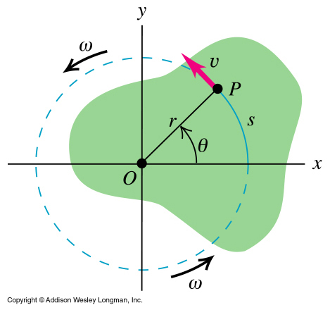
Review:
Displacement and velocity: angular to linear
Distance s = rθ when θ measured in radians.
Speed v = rω
Notes:
We may also want to know some linear properties of particles in the rigid body, such as the distance moved or the velocity v or linear accn a. How do we get these from the rotational quantities ?
Let’s tackle distance first. The distance s that point P moves is r theta when theta measured in radians. (s=r theta)
The speed v of point P equals r omega when omega in rad/s. (get this from s=r theta, ds/dt = v = r d theta/dt and d theta /dt = omega so v = r omega. The direction of this speed is at a tangent to the circular path.

Slide 30
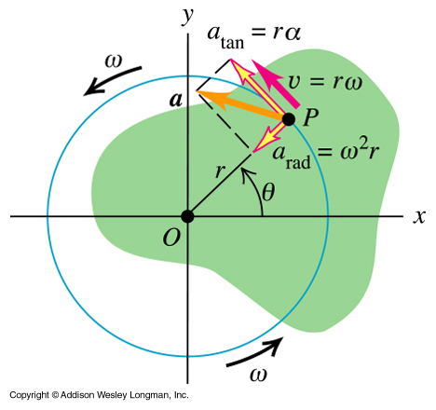
Review:
Acceleration: angular to linear
The component of acceleration of point P parallel to v is a_{tan} = r α
The component perpendicular to v, radially inward, is a_{rad} = ω² r = v²/r
Notes:
Now let’s see what we can do with the accn. Remember circular motion ? We looked at the case where the speed was constant and saw that the centripetal component of accn, the radial component, the component that was directed towards the centre of the circle in which the particle moved was given by a (rad) = v squared/r ? Well let’s replace v squared with omega squared r squared ( v=r omega) and we get a(rad)=omega squared*r. This is the radial component of accn, the one that changes the particle’s direction only and keeps it in a circle.
If the rotation is also speeding up or slowing down then the angular velocity omega is not constant and so there must be a component of accn that is changing the velocity. It is always at a tangent to the circular path of the particle and called tangential accn. A(tan)=dv/dt (ie rate of change of velocity as this part of accn is responsible for the change in magnitude of velocity)=r * d omega/dt (v=r omega) and d omega/ dt = alpha. So the component of acceleration of point P parallel to v is a(tan) = r alpha; the component perpendicular to v, radially inward, is a(rad)= omega squared r.
Let’s do some examples (EXAMPLE 4 AND 5) see next slides for piccis.

Slide 31
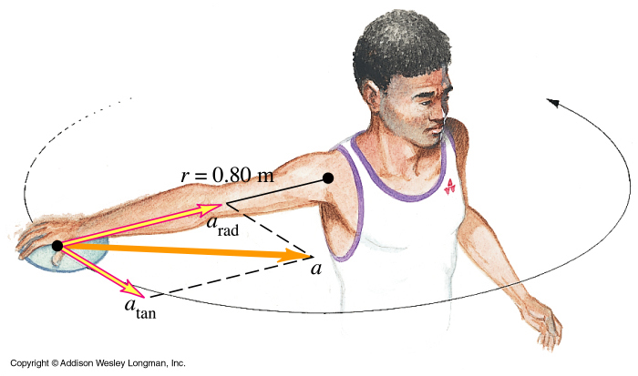
Example 9.4 Throwing a discus
A discus thrower moves the discus in a circle of radius 80 cm. At a certain instant, the thrower is spinning at an angular speed of 10 rad/s and the angular speed is increasing at 50 rad/s².
Notes:
Example 9-4

Slide 32
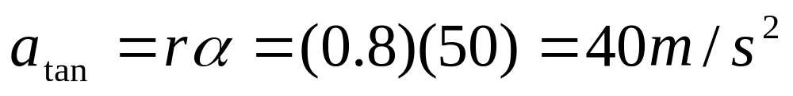


Example 9.4 Throwing a discus (cont)
At this instant find the tangential and centripetal components of the acceleration and the magnitude of the acceleration.

Slide 33


Centripetal Water Pumps- use angular acceleration
If the sun instantly disappeared, the planets would continue in their direction. How long would it take for the planets to stop being accelerated inwards?
It could be thought of as instantaneous, however , since northing, including gravity waves can travel faster than the speed of light, it would take longer than 5 minutes
Notes:
If the centripetal force- which is supplied by gravity is turned off- the object then moves straight ahead.
One more unrelated point to think about.
What would happen to the planets if the sun instantantly dissapear. Would they instantly move straight ahead, or would they wait, the time it takes light to reach them before they move straight ahead.
Newton says – instantly
Einstein says- take time- the speed of light.

Slide 34


